Slide 1
Version Image

Slide 2
edge_shape.m
The simplest
The edge seen from the side
Direction A
Direction B
Human
Direction B
Snow board
Direction A

Slide 3





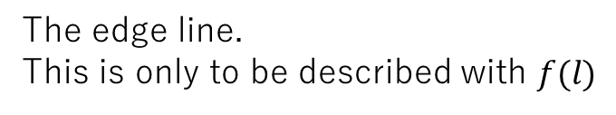
edge_shape.m
$$l$$
$$f(l)$$
Plane $α$
x
$$f(l)$$
Y
y
The edge line.
This is only to be described with $f(l)$
$$α$$
z
y
x
The center line.
I decide that it only bents to z direction;
this line does not bent x and y direction.

Slide 4


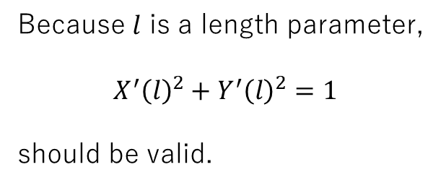
edge_shape.m
Because $l$ is a length parameter, $$X^{′}{\left(l\right)}^{2}+Y^{′}{\left(l\right)}^{2}=1$$ should be valid.
Plane $α$
$$(X\left(l\right), Y\left(l\right))$$
Y
X

Slide 5
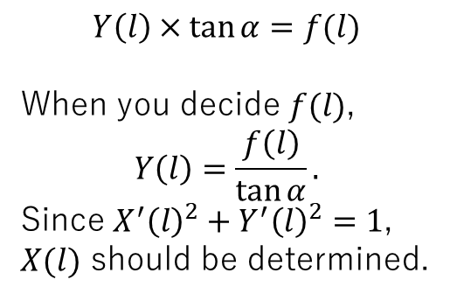






edge_shape.m
z
Plane $α$
The point on the center line at the length of $l$
I decided this angle equals to 90°
$$Y(l)$$
$$α$$
$$f(l)$$
y
$$Y\left(l\right)×\tan{α}=f(l)$$
When you decide $f(l)$, $$Y\left(l\right)=\frac{f\left(l\right)}{\tan{α}}.$$
Since $X^{′}{\left(l\right)}^{2}+Y^{′}{\left(l\right)}^{2}=1$, $X(l)$ should be determined.
$$\frac{Y\left(l\right)}{\cos{α}}$$
The point on the edge line at the length of $l$

Slide 6
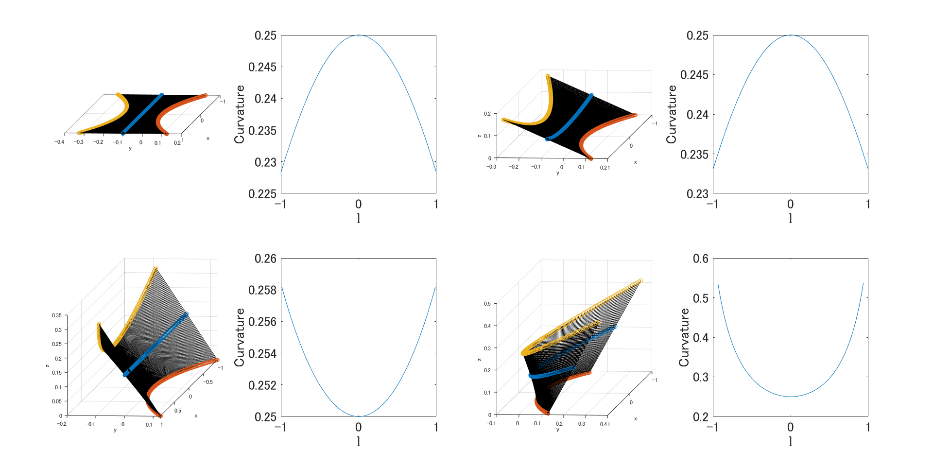
edge_shape.m

